Slide 1



ANATOMY OF THE MALE GENITAL SYSTEM
Dr Tampaki Ekaterini Christina, Plastic and Reconstructive Surgeon
Dr Filippou Dimitrios, Assistant Professor- General Surgeon
Dr Sinou Natalia, PhD candidate

Slide 2
Male Anatomy
Primary Organ
– testes, genetically determined in mammals
- testis releases hormones that then control the development of secondary sex characteristics
Secondary Organs
  internal duct system
    e.g., vas deferens, epididymus
  external genitalia
Secondary Sexual Characters
  e.g., antlers, coloration, facial hair

Slide 3
The male genital system consists of the following genital organs
:
Testis
Ejaculatory duct
Epididymis
Prostate
Ductus deferens (vas)
Bulbourethral gland
Spermatic cord
Male urethra
Scrotum
Penis
Seminal vesicle

Slide 4
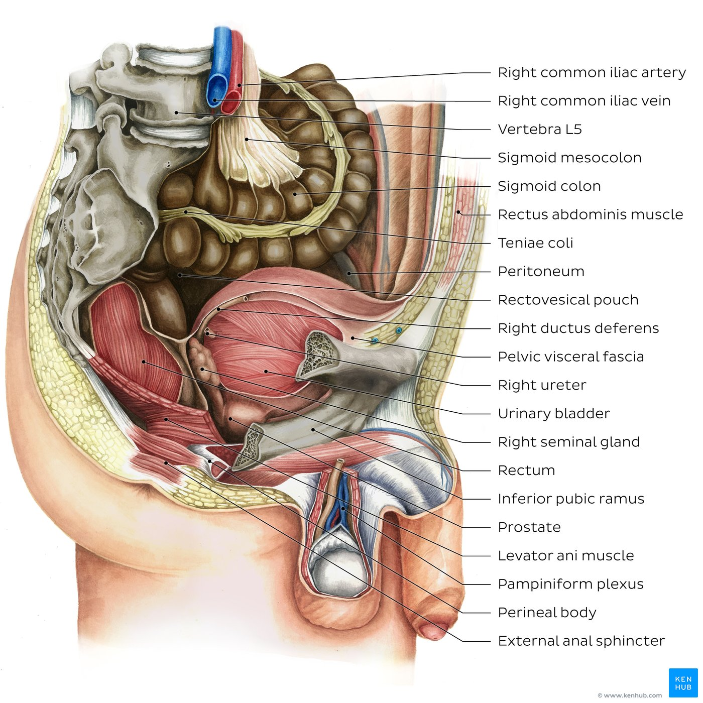
Male pelvic cavity
Parasagittal section of the male pelvis and perineum (right view) with parts of the right pelvic wall and fascia removed to show the relations of the male pelvic organs.
The urinary bladder is located anteriorly within the pelvic cavity, posterior to the pubic bone. The prostate sits immediately inferior to the urinary bladder. The terminal part of the sigmoid colon continues distally as the rectum, both of which are located in the posterior aspect of the pelvic cavity, anterior to the sacrum and coccyx. The pelvic part of the ureter, ductus deferens and seminal vesicle are centrally located in the image, between the urinary bladder and the rectum.

Slide 5
Key points about the male pelvic cavity
Walls and floors | Bones: Hip bone (ilium, ischium, pubis), sacrum, coccyx Ligaments: Sacroiliac, sacrospinous, and sacrotuberous Muscles: Levator ani, coccygeus, piriformis, obturator internus
Digestive organs | Organs: Sigmoid colon, rectum Functions: Absorption of minerals, vitamins, water and electrolytes, temporary storage of fecal matter and elimination during defecation
Reproductive organs | Organs: Prostate, seminal vesicles, ductus deferens Functions: Secretion of protein and nutrient rich fluid that contributes to volume of semen, transport of semen
Urinary organs | Organs: Pelvic part of ureter, urinary bladder Functions: Transport and elimination of urine from from the body
Peritoneal pouches | Rectovesical pouch (between the rectum and urinary bladder)
Blood supply | Internal iliac artery: Superior vesical arteries, inferior vesical artery, internal pudendal artery, middle [ano]rectal artery Superior [ano]rectal artery (from inferior mesenteric artery) Median sacral artery (from aortic bifurcation)
Innervation | Sympathetic: Lumbar splanchnic nerves, hypogastric and pelvic plexuses Parasympathetic: Pelvic splanchnic nerves, left and right inferior hypogastric plexuses, and rectal (pelvic) plexus

Slide 6
Key facts about the male reproductive organs
Internal genitalia | Testis, epididymis, ductus deferens, ejaculatory ducts, seminal, prostate and bulbourethral glands
External genitalia | Distal urethra, scrotum and penis
Blood supply | Internal genitalia: testicular, superior vesical and inferior vesical arteries, middle rectal arteries External genitalia: internal pudendal, external pudendal arteries
Innervation | Internal genitalia: Lumbar splanchnic nerves, hypogastric and pelvic plexuses (sympathetic); pelvic splanchnic nerves (parasympathetic) External genitalia: Pudendal nerve (sensory, sympathetic, somatic motor); prostatic plexus (parasympathetic) Mnemonic: Point & Shoot (Parasympathetic system controls erection, Sympathetic system controls ejaculation)
Lymphatic drainage | Testes: paraaortic lymph nodes Other genitalia: inguinal lymph nodes, internal iliac lymph nodes
Clinical relations | Adenocarcinoma, benign prostatic hyperplasia, cryptorchidism

Slide 7
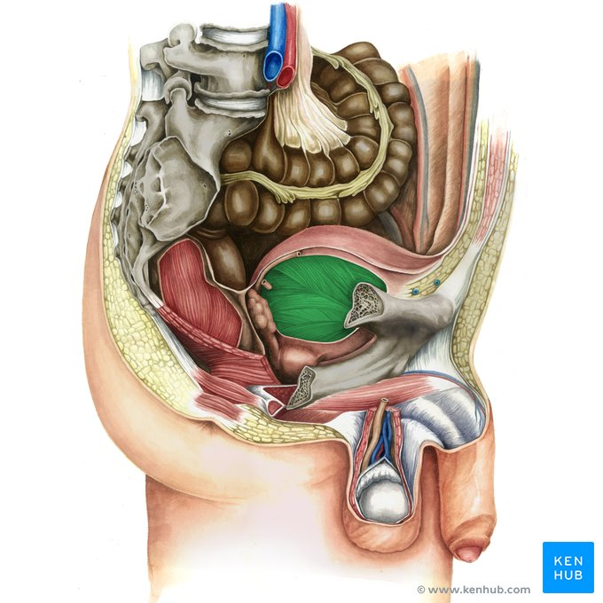
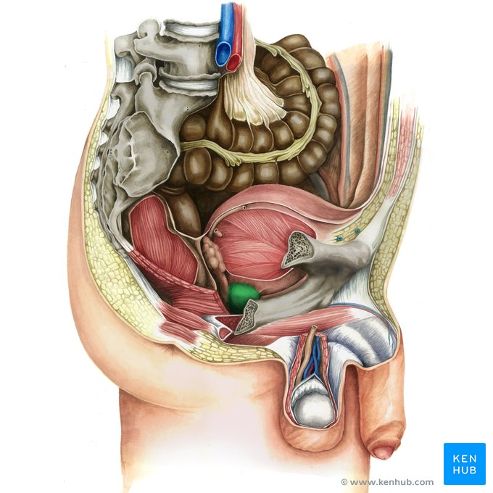



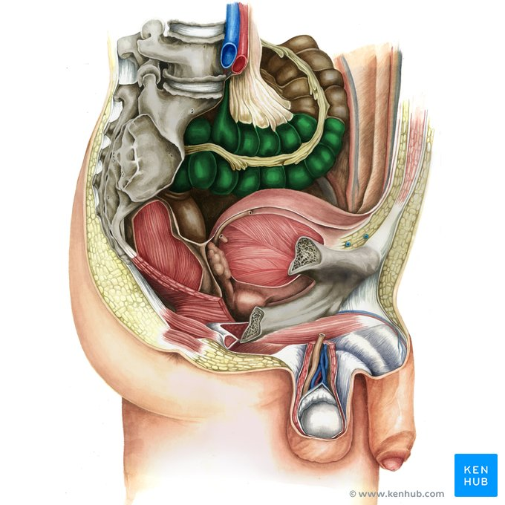
Urinary bladder, prostate, right ureter, right ductus deferens, right seminal gland, sigmoid colon.

Slide 8
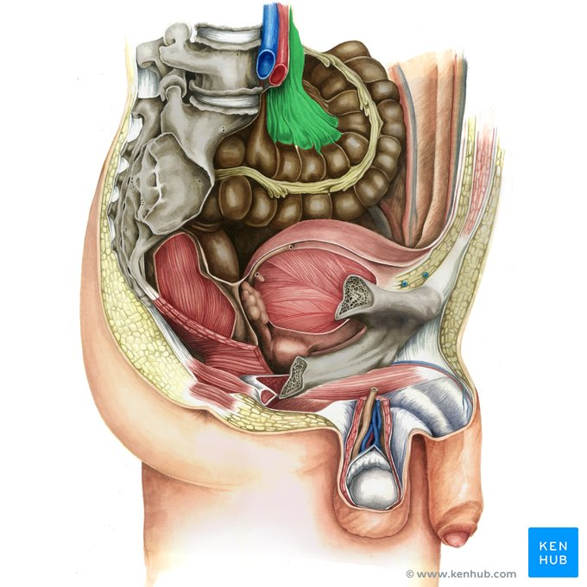
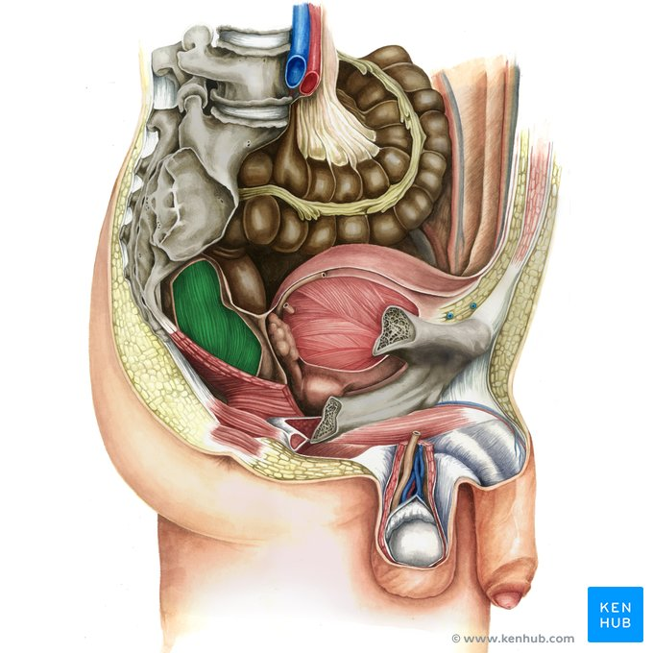
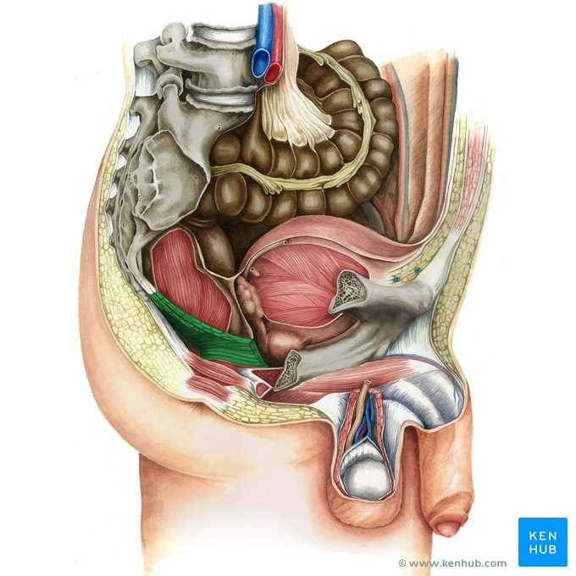
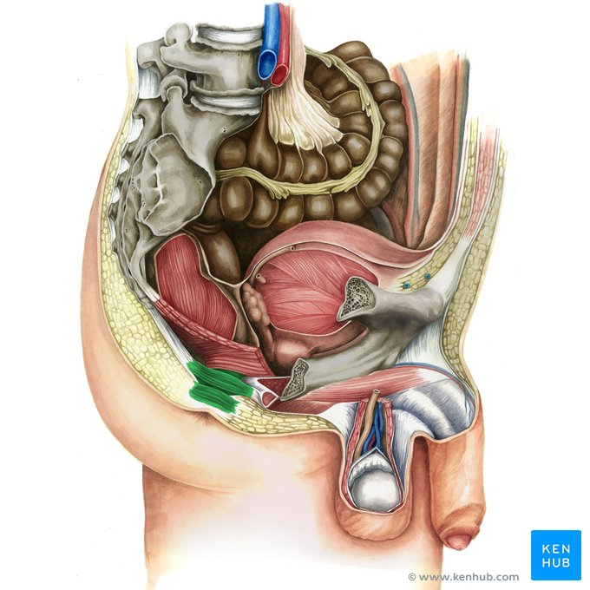


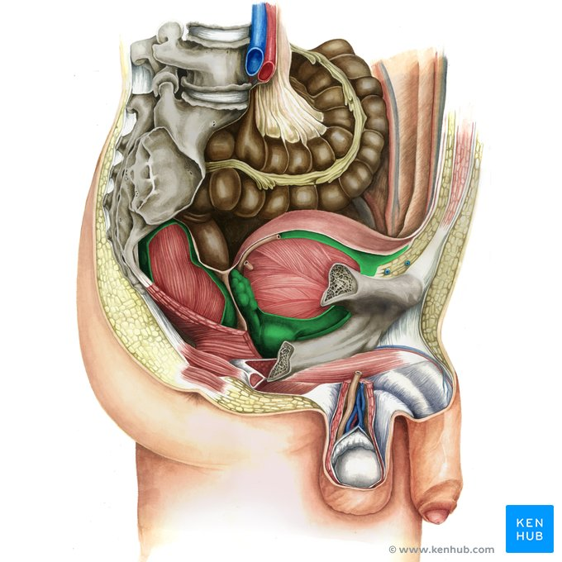
Sigmoid mesocolon, rectum, levator ani muscle, external anal sphincter, perineal body, rectovesical septum, pelvic visceral fascia

Slide 9

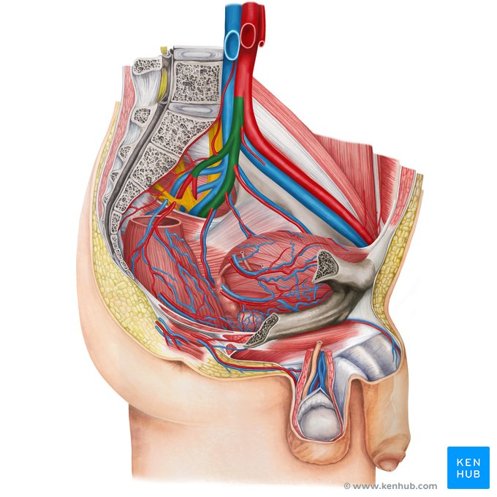
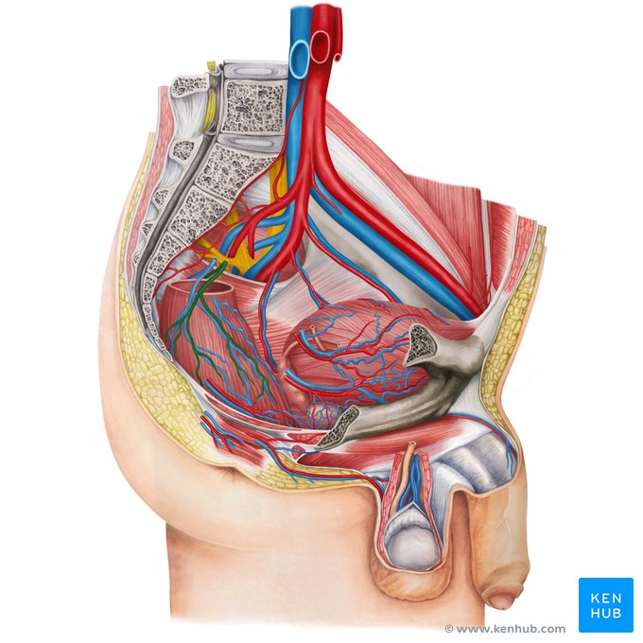
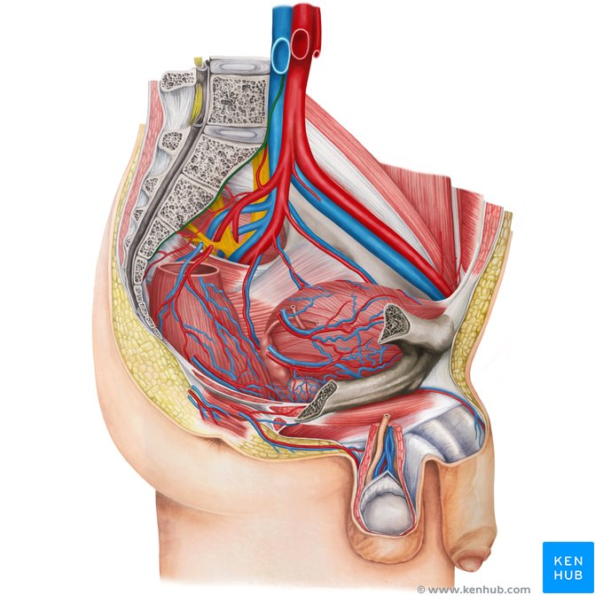
Right common iliac artery –vein, left internal iliac artery, superior anorectal artery, median sacral artery,

Slide 10
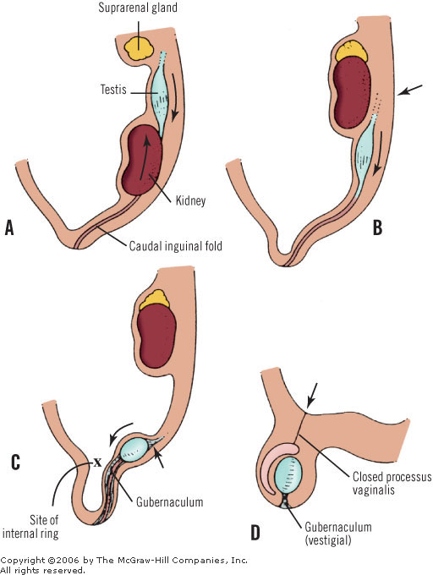
DESCENT OF THE GONADS

Slide 11
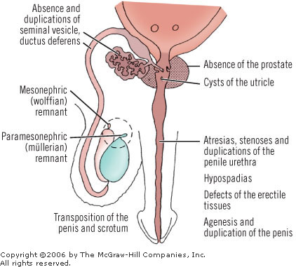
5TH WEEK
The testis that has not begun its descent is, together with the epididymis, attached to the posterior abdominal wall by a mesorchium that contains the blood vessels and the ductus deferens.
It may lie at the level of the lower pole of the kidney, the iliac fossa, or in the pelvis

Slide 12
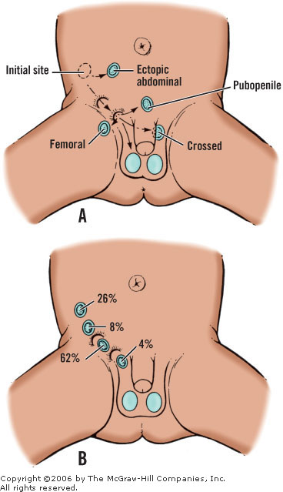
UNDESCENDED TESTIS

Slide 13
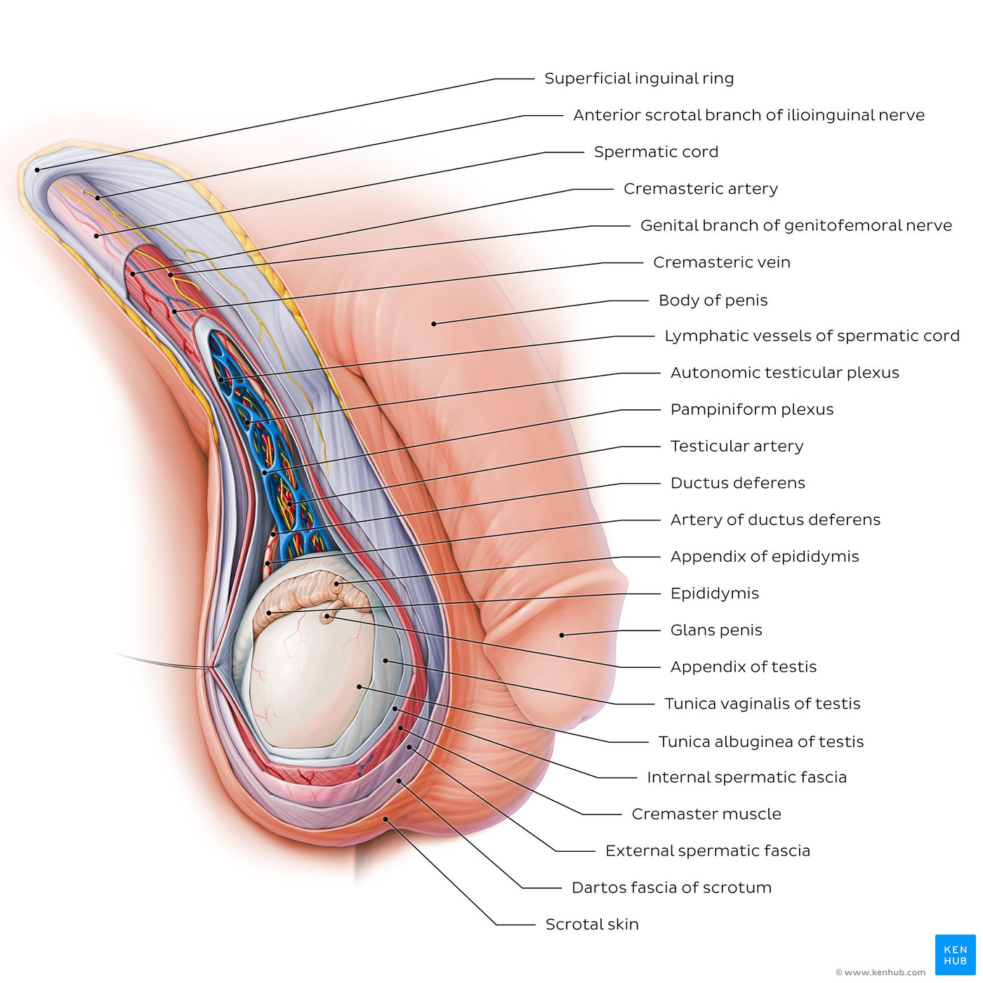
Scrotum and spermatic cord
The scrotum is a cutaneous sac that contains the testes and lower parts of the spermatic cord.
It consists of two layers: skin (superficially) and dartos fascia of scrotum (deep). Smooth muscle fibers of the dartos muscle pervade through the dartos fascia. Contraction of the dartos muscle gives the scrotum its wrinkled appearance.

Slide 14
Layers of the Scrotum
Scrotal Skin (Layer 1)
Dartos (Layer 2)
External Spermatic Fascia (Layer 3)
Cremaster Muscle (Layers 4 and 5)
Internal Spermatic Fascia (Layer 6)
Preperitoneal Fat (Layer 7)
Tunica Vaginalis (Layer 8): a serous membrane of peritoneum. Layers 7 and 8 are constituents of the cord

Slide 15
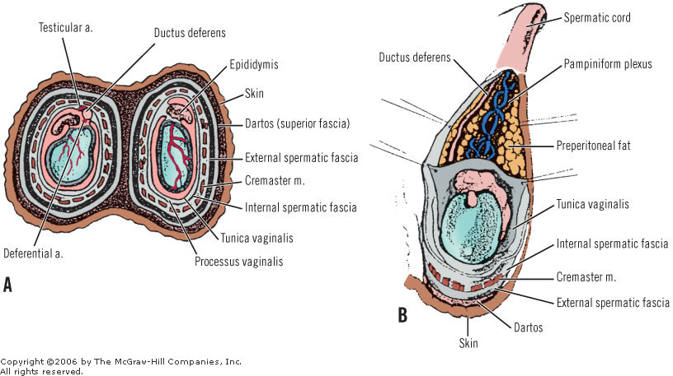
SCROTUM LAYERS

Slide 16
Scrotum
Key points about the scrotum
Contents | Testes, epididymis, lower parts of spermatic cords
Layers | Skin, dartos fascia (dartos muscle), external spermatic fascia, cremasteric fascia (cremaster muscle) and internal spermatic fascia
Function | Maintains optimal temperature for spermatogenesis
The scrotum allows the testes to be positioned outside of the body. The primary scrotum function is to maintain adequate temperature for the testes to produce sperm.
This is achieved by the conjunction of two muscles: the dartos muscle of scrotum, which regulates the surface area of the scrotum by contracting/wrinkling the skin, and the cremaster muscle whose contraction pulls the testes closer to the body when the outside temperature is low.
Scrotum blood supply relies on the scrotal branches of the internal and external pudendal arteries. For innervation, branches of the lumbar plexus supply the anterior part of the scrotum, while branches of the sacral plexus supply its posterior region.

Slide 17
Key points about the spermatic cord
Contents | Ductus deferens, artery to ductus deferens, testicular artery, pampiniform plexus of veins (testicular veins), cremasteric artery and vein, genital branch of the genitofemoral nerve, autonomic testicular plexus, and lymphatic vessels
Coverings | Internal spermatic fascia, cremasteric fascia (cremaster muscle), external spermatic fascia
Function | Contains structures running to and from the testis; suspends the testis in the scrotum

Slide 18
Spermatic cord
The spermatic cord is a matrix of connective tissue continuous proximally with the preperitoneal connective tissue. Concentrically invested by three layers of tissue, the cord contains the ductus deferens (vas), three arteries, three veins, the pampiniform plexus, and two nerves. One other nerve, the ilioinguinal, lies just lateral to the major layers of the cord.
The elements of the spermatic cord relate to each other as follows.
Anterior: pampiniform plexus
Posterior: ductus and remnant of processes vaginalis or hernial sac
These anatomic entities of the spermatic cord, as well as others, are covered by the spermatic fasciae. The spermatic cord on its way to the scrotum may be found deep under the fasciae of Scarpa and Colles.
The components of the spermatic cord are listed in Table 25-3. The key to remember is "three": three layers of fasciae, three arteries, three veins, three nerves, multiple lymphatics, and one ductus.

Slide 19
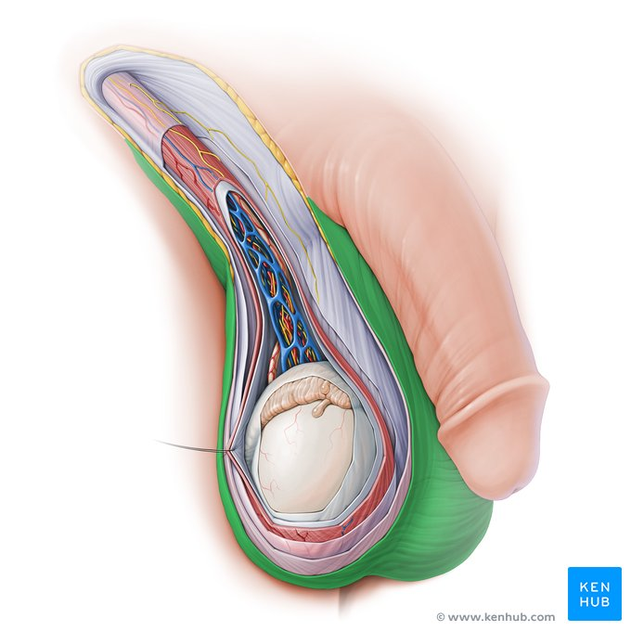
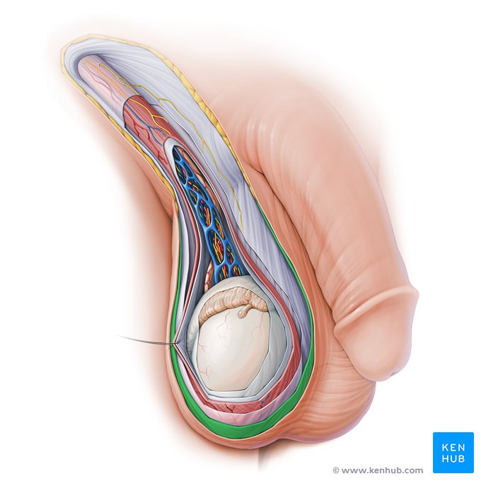
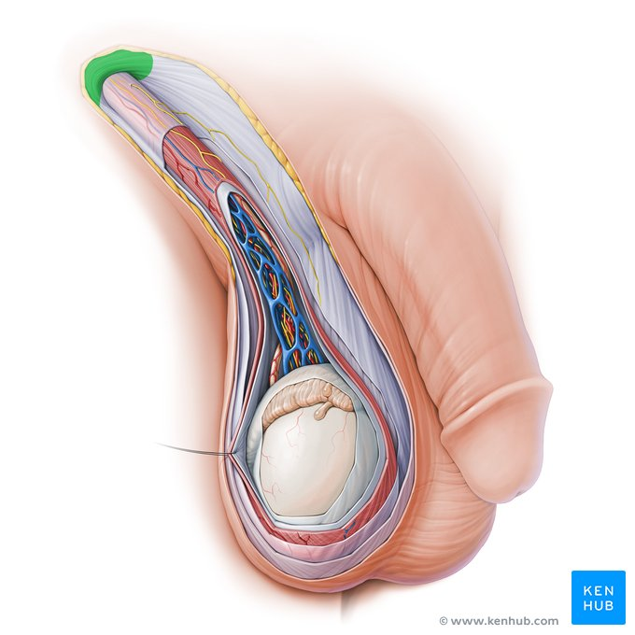
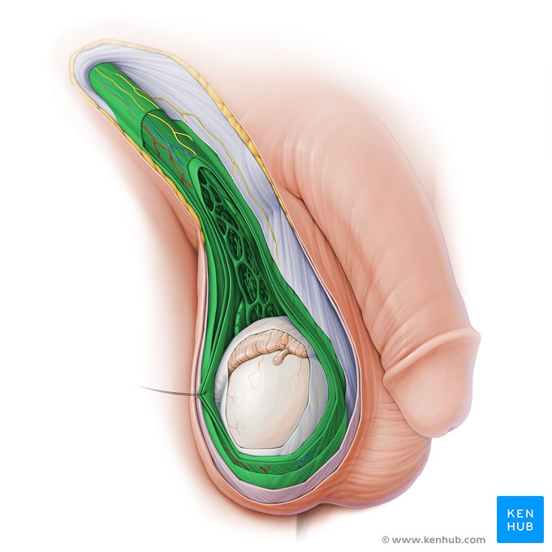
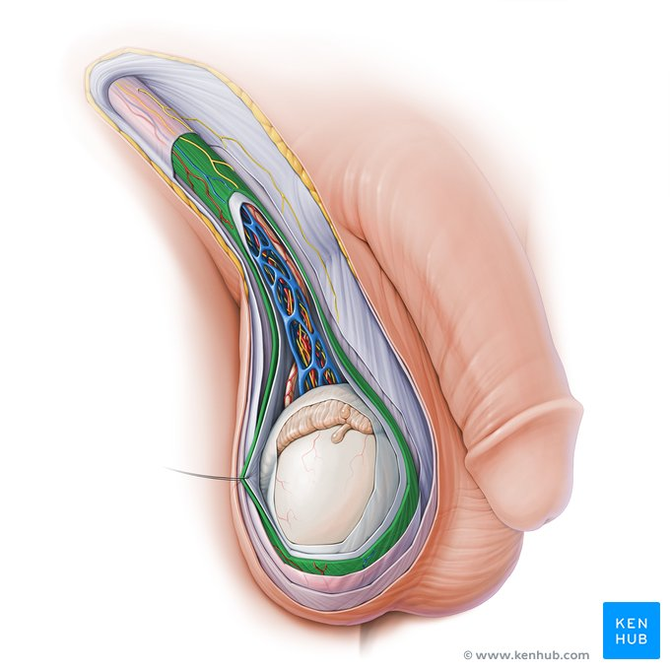
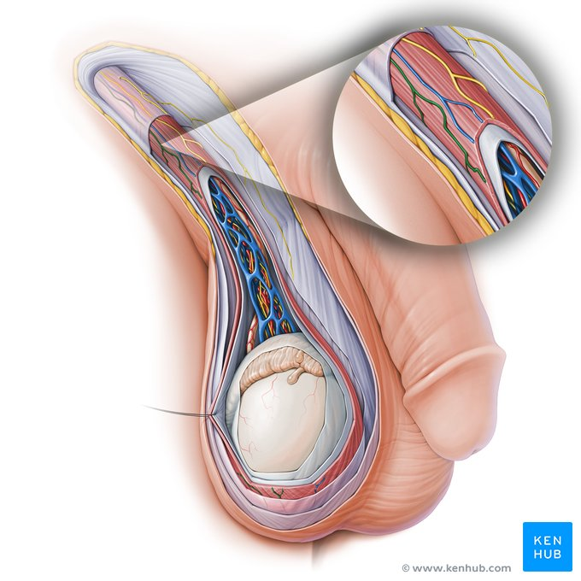
Scrotal skin, dartos fascia of scrotum, superficial inguinal ring, spermatic cord, cremaster muscle, cremasteric artery –vein.

Slide 20
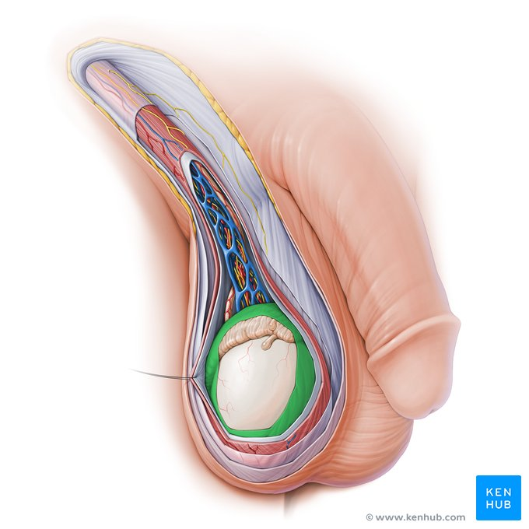
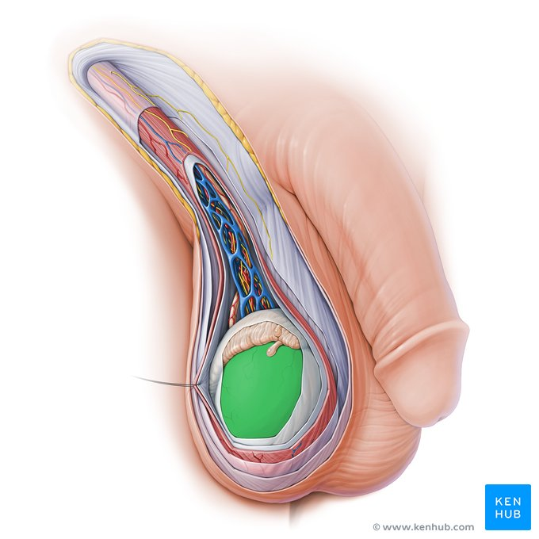
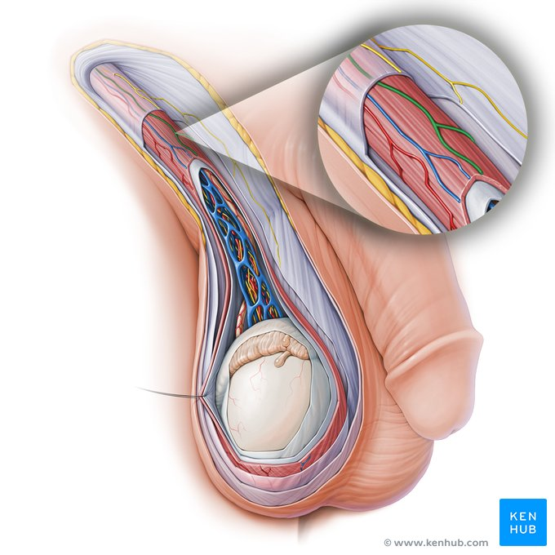
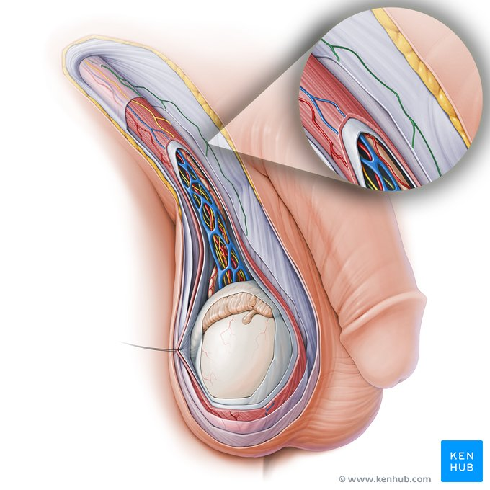
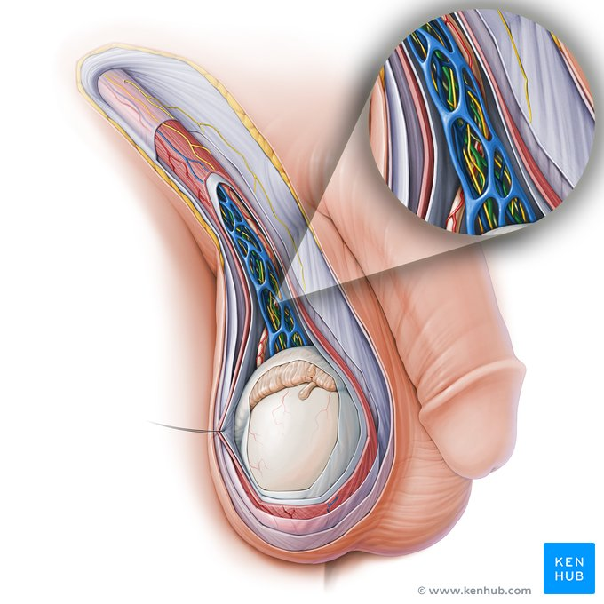
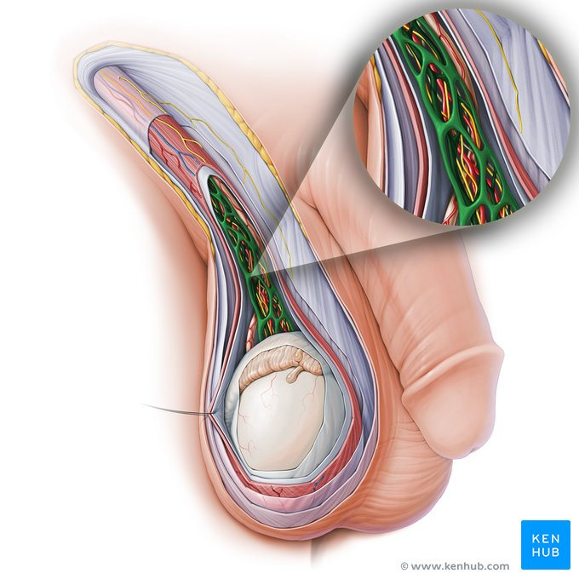
Tunica vaginalis testis, tunica albuginea testis, genital branch of genitofemoral nerve, anterior scrotal branch of ilioinguinal nerve﻿, testicular artery, pampiriform plexus

Slide 21
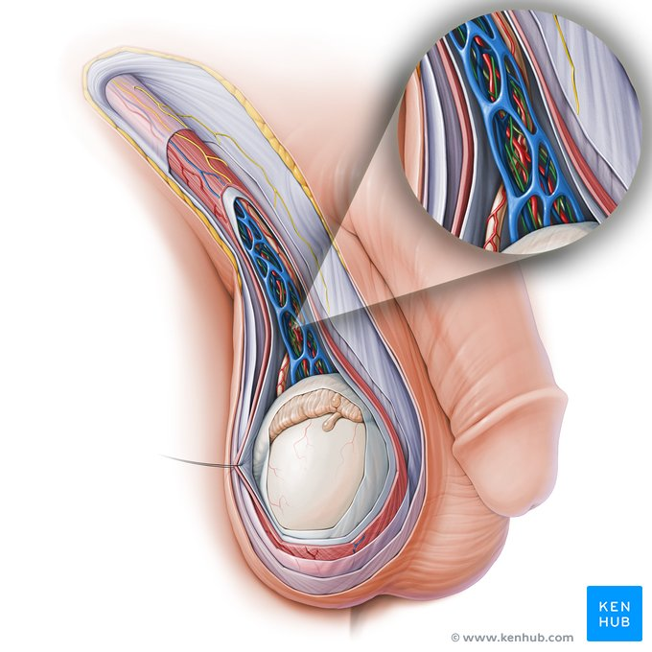

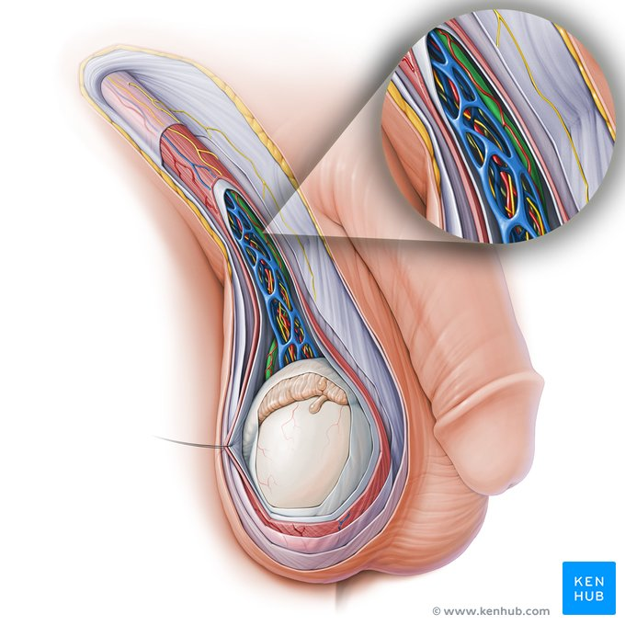
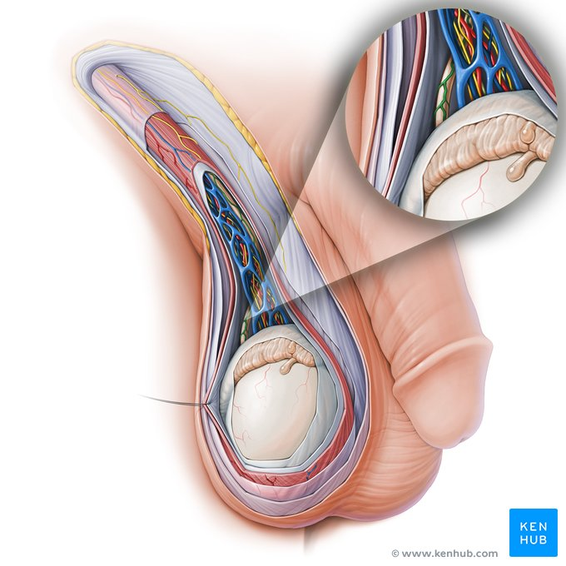

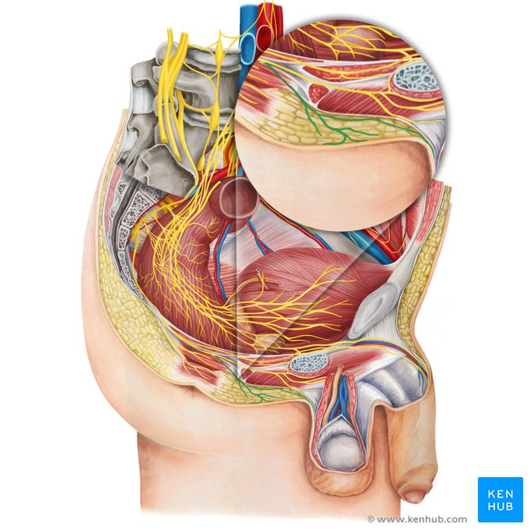
Autonomic testicular plexus, lymphatic vessels of spermatic cord, ductus deferens, artery of ductus deferens, posterior scrotal arteries, - nerves

Slide 22
Testis
The normally descended testis is ovoid and about 4 cm in length. The tunica vaginalis of peritoneum envelops the whole testis except its posterior border and its superior pole.
The testis itself is surrounded by a dense, irregular connective-tissue capsule, the tunica albuginea. Posteriorly, the tunica forms a median septum, the mediastinum testis, from which more delicate connective tissue divides the parenchyma into 200 to 300 compartments that contain the seminiferous tubules. These coiled tubules anastomose in the mediastinum of testis to form the rete testis, from which 6 to 12 ductuli efferentia pass to the head of the epididymis.
The testis has two free surfaces, the medial and the lateral, and two borders, the anterior and the posterior. The posterior border has a superior portion that is related to the head of the epididymis, and an inferior portion that is related to the body and tail of the epididymis.
The right testicle, in most cases, is at a higher level than the left. Occasionally, the right testicle is lower in total situs inversus in left-handed men. For medicolegal reasons, this finding should be reported in the patient's chart.

Slide 23
Epididymis
The head of the epididymis is firmly fixed to the upper pole of the testis.
The body and the tail are less firmly fixed to the posterior border of the testis. This posterior surface is not covered by the tunica vaginalis, but it is the site of the blood and nerve supply to both organs.

Slide 24
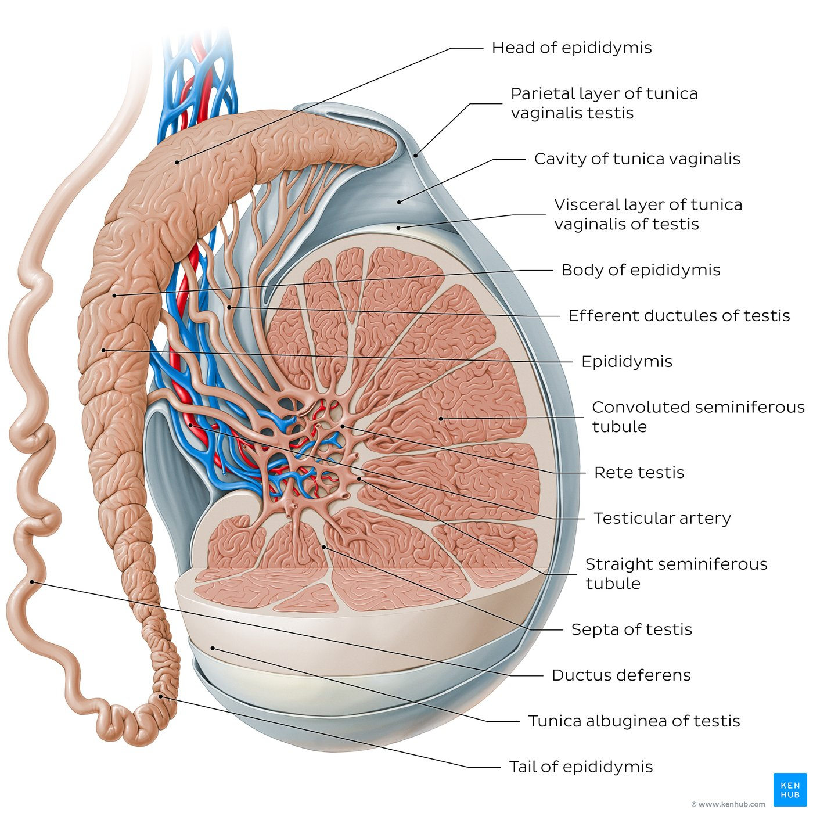
Testicle and epidydimis anatomy 1
The testes: (singular: testis) two oval-shaped male internal genital organs found within the scrotum.
Their function is to produce sperm and the hormone testosterone.

Slide 25
Testicle and epidydimis anatomy 2
Testes comprise an intricate network of tubules and dispersed secretory cells. The former are the convoluted seminiferous tubules and rete testis, and the latter are Leydig and Sertoli cells. Each of them plays a vital role in spermatogenesis. Spermatozoa are conveyed from the testis via the epididymis and its continuation the ductus deferens (vas deferens). Ductus deferens leaves the scrotum by traversing the spermatic cord.
Testes and epididymides are supplied by the testicular arteries. Venous drainage is provided by the pampiniform plexus and testicular veins. They are innervated by the autonomic testicular plexus.
The epididymis is located on the posterior surface of the testis. It is made up of series of ducts and its main function is storage and maturation of spermatozoa. The epididymis is divided into three parts: the head, which is connected to the testis efferent ductules, the body and the tail. The epididymis tail continues distally as the ductus deferens.

Slide 26
Sum up: testis - epididymis
Key points about testis and epididymis
Testis | Contents: Lobules, septa, mediastinum of testis, seminiferous tubules (convoluted/straight), rete testis, efferent ductules. Coverings: Tunica vaginalis (composed of parietal and visceral layers), tunica albuginea, tunica vasculosa. Functions: Production of sperm, hormone production and secretion.
Epididymis | Location: Overlies superoposterior aspect of testis. Structure: Formed by efferent ductules from testis → join together in head and body → become single duct in tail → continues as ductus deferens. Function: Maturation of sperm.

Slide 27
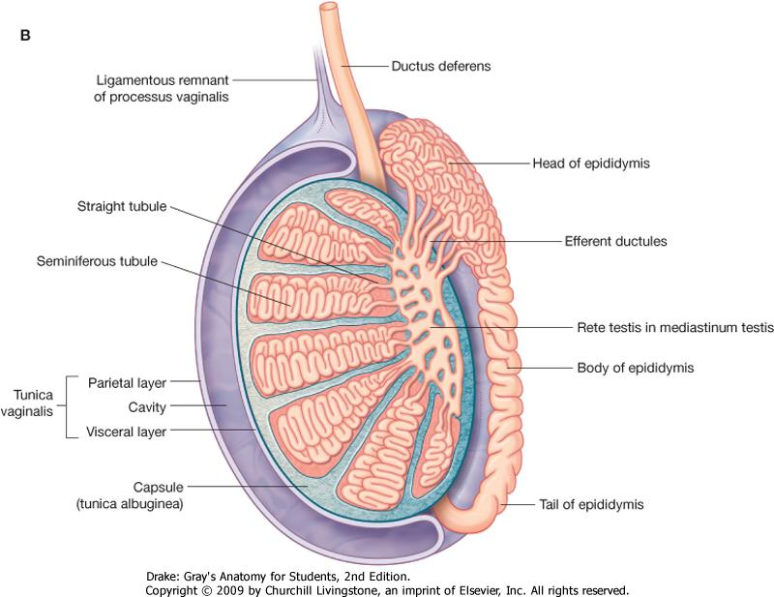
Testis
Tunica albuginea
Seminiferous tubules
Rete testis
Head of epididymis
Body of epididymis
Tail of epididymis

Slide 28
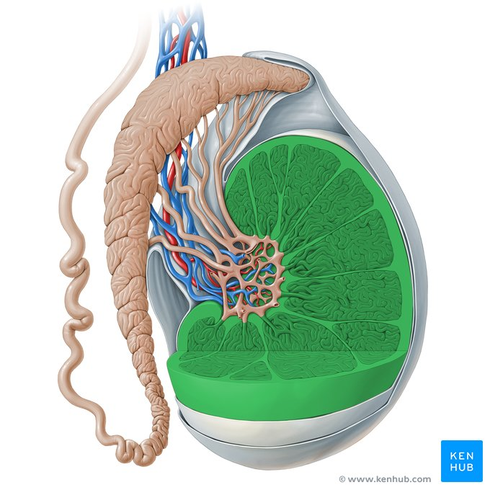
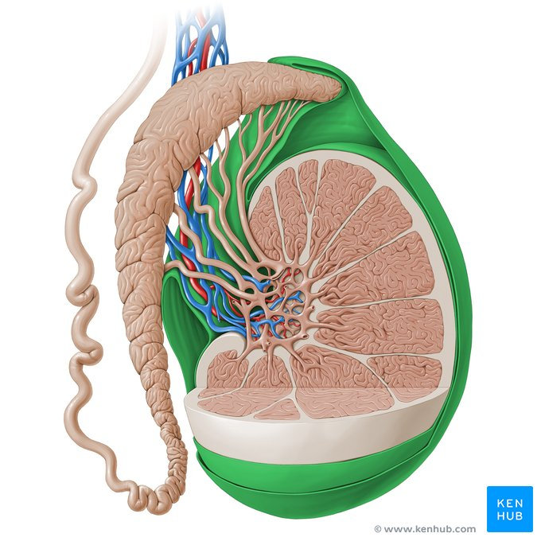
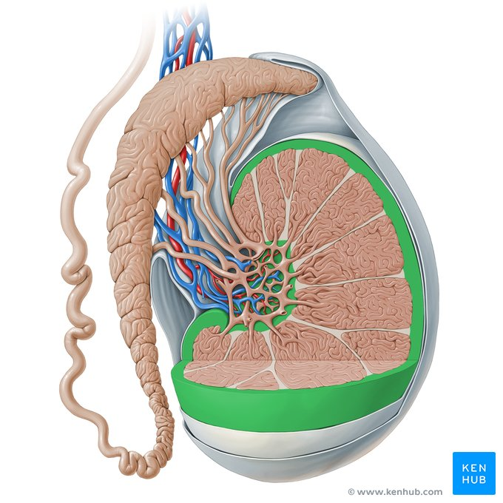
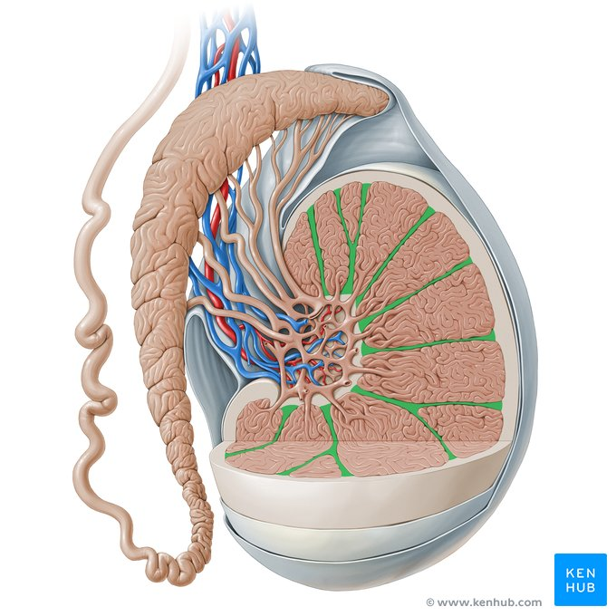
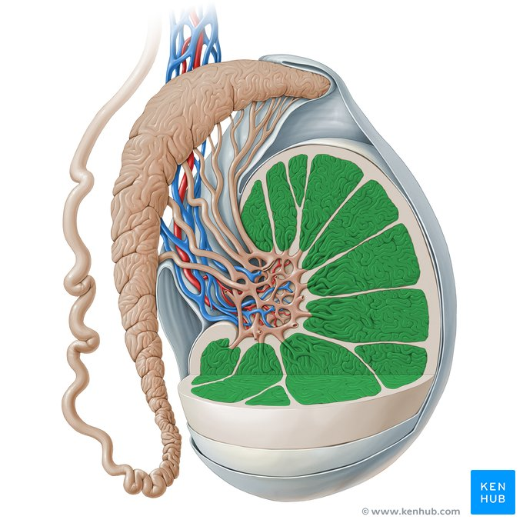
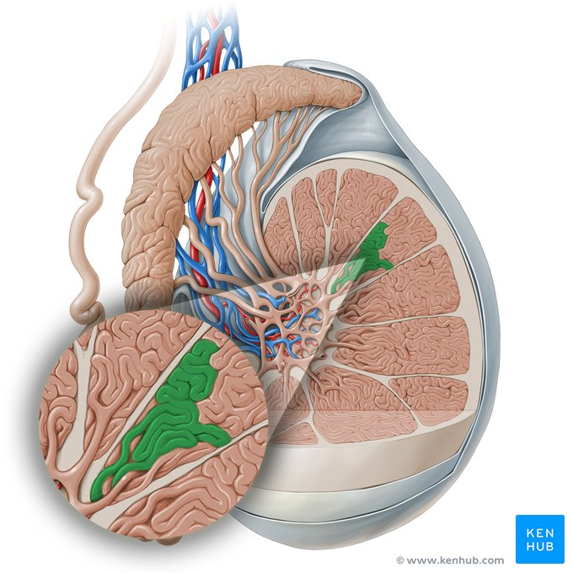
Testis, tunica vaginalis testis, tunica albuginea testis, septa of testis, lobule of testis, convoluted seminiferous tubule.

Slide 29
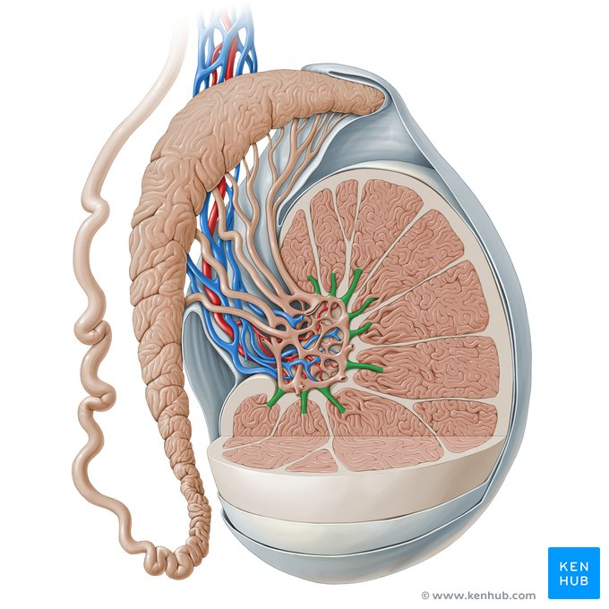
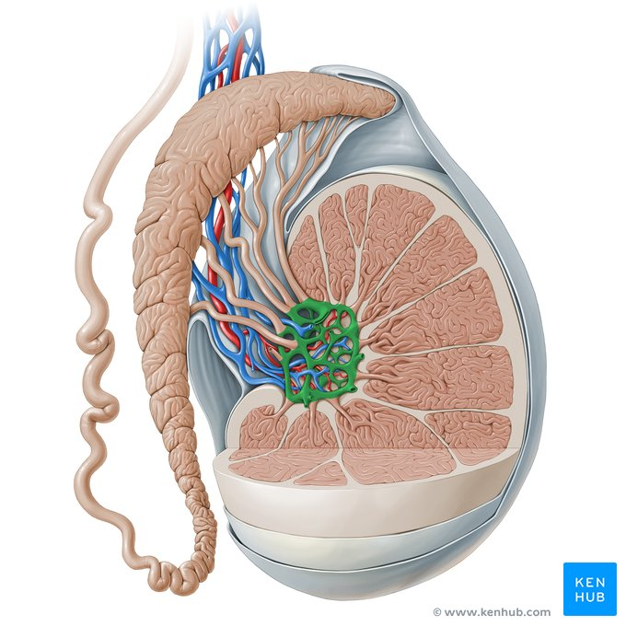
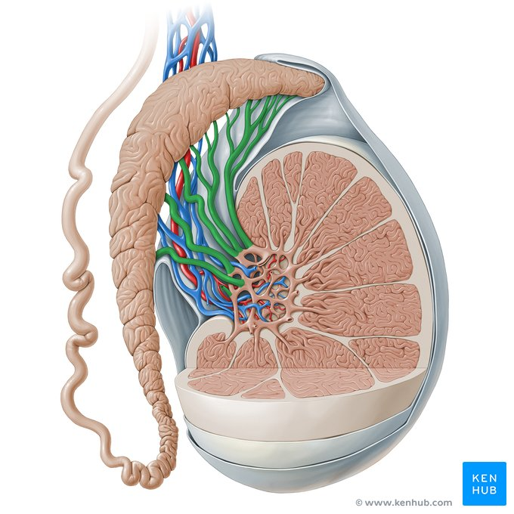
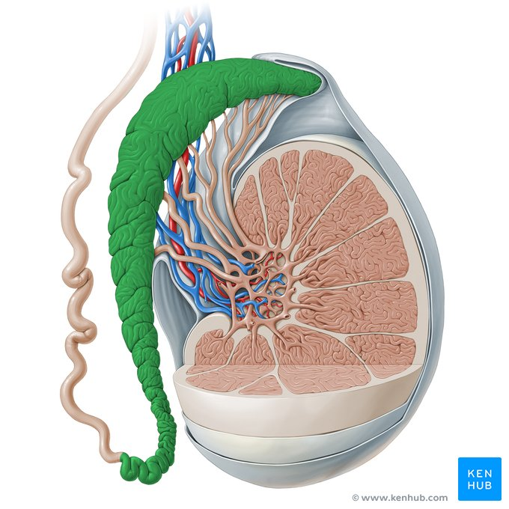
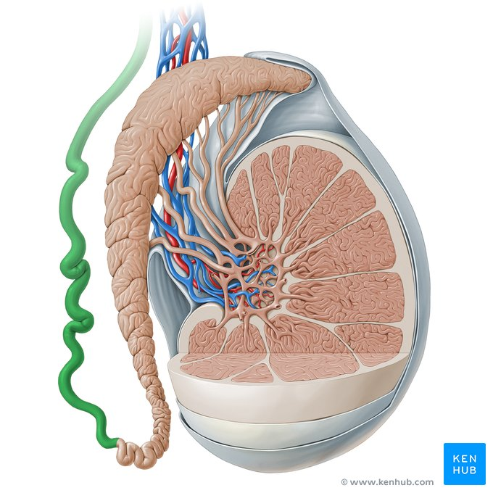
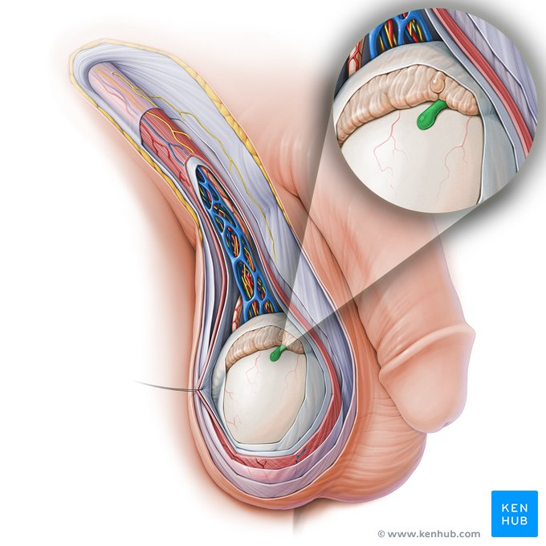
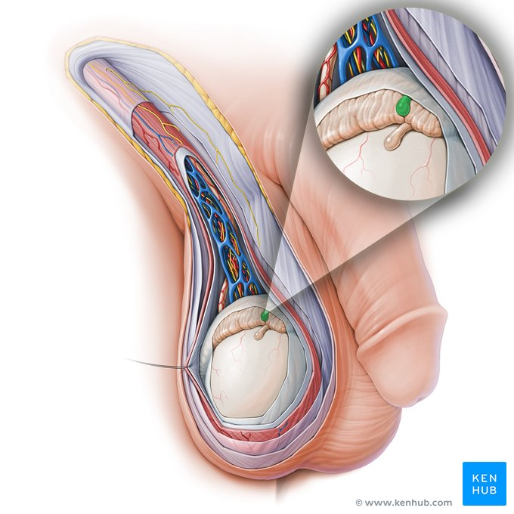
Straight seminiferous tubule, rete testis, efferent ductules of testis, epidydimis, ductus deferens, appendix of testis, appendix of epidydimis

Slide 30
Malignancy
There is definitely an increased incidence of malignancy in cryptorchid testes. It appears that an undescended testis is thirty-five times more likely to be found in those with testicular tumors than in the general male population

Slide 31
Processus Vaginalis
The proximal part of the processus vaginalis (from the peritoneal cavity to the testis) closes after descent is complete. Closure is complete by birth in 50% to 75% of infants. Scorer believed that this closure may be recognized by palpating the spermatic cord shortly after birth.

Slide 32
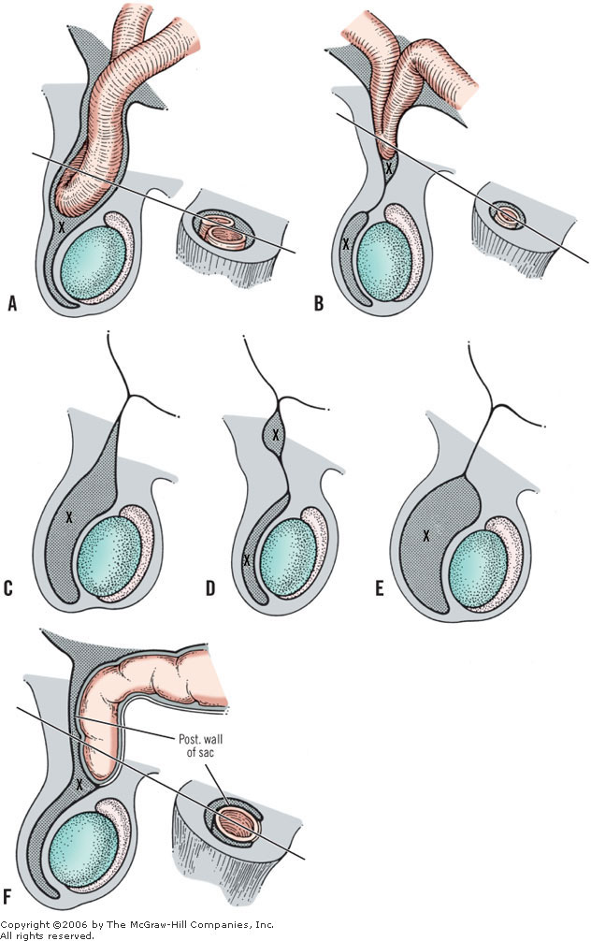
Defects of closure of processus vaginalis

Slide 33
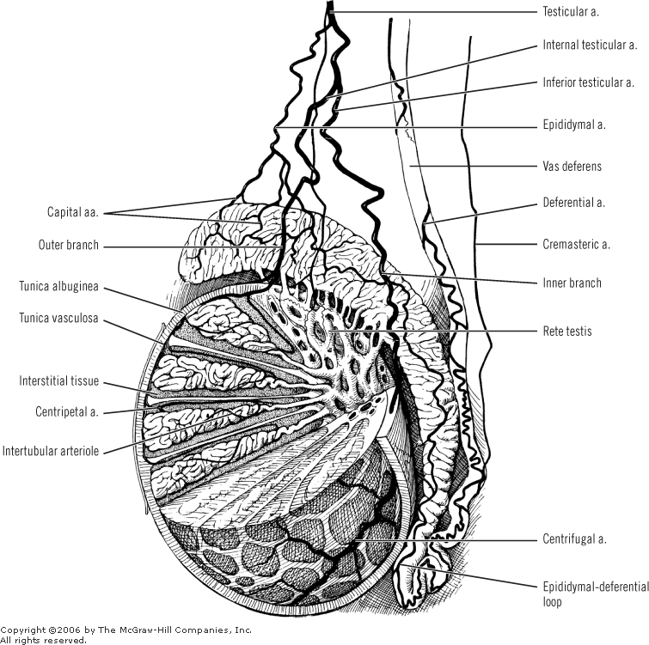
Illustrations: Surgical anatomy and vascular supply of testis

Slide 34

Vena cava and tributaries

Slide 35


Slide 36
VAS DEFERENS
The ductus deferens starts where the epididymal duct (epididymal tail) ends and terminates at the ejaculatory duct .
The ductus has a length of about 45 cm. Characteristically, its tortuous proximal part and almost straight distal part are dilated.

Slide 37
Pathway of Ductus Deferens
The pathway of the ductus is scrotal, inguinal, abdominal, and pelvic.
Within the scrotum, the ductus has an ascending course at the medial side of the epididymis and the posterosuperior area of the testicle.
Within the inguinal canal, the ductus is incorporated into the spermatic cord. It is located posteromedially in the cord, and is surrounded by the venous pampiniform plexus.
At the deep inguinal ring (abdominal), the ductus leaves the cord. It proceeds toward and into the pelvis after looping over the inferior epigastric artery and in front of the external iliac artery and vein. In the pelvis, the ductus descends from the pelvic sidewall with its deferential arterial supply, supported by a delicate mesentery.

Slide 38

Relations and vasculature of prostate, seminal vesicles, and ductus deferens

Slide 39

SPERMATIC
CORD

Slide 40


PROSTATE

Slide 41


Prostate, seminal gland, bulbourethral gland
The prostate is an unpaired gland of the male reproductive system. It is found inferior to the urinary bladder, and is penetrated by the urethra.
The prostate function is to produce fluid secreted into the urethra during ejaculation.
Its role is supported by the other accessory reproductive glands, that is the seminal vesicle and bulbourethral gland (Cowper’s gland). Male accessory reproductive gland excretions flow into the prostatic part of the urethra via the ejaculatory duct. Together with spermatozoa, they form semen.

Slide 42

PROSTATE

Slide 43


Slide 44

Seminal vesicles and deferent ducts.

Slide 45
The topographic anatomy and relations of the seminal vesicles are as follows:
Anterior and superior: urinary bladder, occasionally fixed
Posterior and inferior: Denonvilliers' fascia (the rectovesical septum) and anorectum
Above: peritoneum in the rectovesical fossa (may be occasionally reached by the tip of the seminal vesicles)
Medial: ductus deferens
Lateral: multiple vesicle vessels and levator ani
Below: ejaculatory duct, where it unites with the ampulla of the ductus deferens

Slide 46
THE COURSE OF EJACULATORY DUCTS
The ejaculatory ducts pass distally through the prostate gland, with the posterior glandular part of the organ behind.
The median lobe of the prostate is in front. The duct has a very thin wall, a length of approximately 2 cm, and a diameter of less than 1 mm.
The ducts end as small openings on either side of the midline on the verumontanum of the urethral ridge

Slide 47

EJACULATORY
DUCTS

Slide 48

Male urogenital anatomy

Slide 49

Prostate Blood Supply
The prostate receives blood supply through branches of internal pudendal artery, inferior vesical artery and middle rectal arteries.
Innervation is provided by parasympathetic fibers of pelvic splanchnic nerves via the prostatic plexus and sympathetic fibers of the inferior hypogastric plexus.

Slide 50


Slide 51


Slide 52


Slide 53


Slide 54

Prostate Nervous 1

Slide 55

Prostate Nervous 2

Slide 56
PROSTATIC SURFACES 1
There are four prostatic surfaces:
one posterior, one anterior, and two inferolateral.
The posterior surface is flat transversely and convex vertically. It is separated from the rectal ampulla by the bilaminar fascia of Denonvilliers. This surface is characterized by a midline groove that is wider toward the base of the gland and serves to partially separate the gland posteriorly into left and right lobes.
The posterior surface may be palpated by digital rectal examination. The vesicoprostatic junction is located at the upper border of the posterior surface.

Slide 57
PROSTATIC SURFACES 2
The narrow and convex anterior surface is located between the apex and the base. Multiple large veins separate this surface from the symphysis pubis. According to Tanagho the distance between the pubic symphysis and the anterior surface is approximately 2 cm.
The avascular puboprostatic ligaments are fibrous cords, wide or narrow. They connect the upper limits of the anterior surface of the prostate to the pubic bone, at the right and left sides of the cartilaginous area.
The right and left inferolateral surfaces are embraced by the anterior part of the levator ani muscles. They are fixed to the levator by the arcus tendineus of the fascia pelvis ("white line"), sagittal connective tissue bands between the ischial spine, and the pubic bone. Here there is a very rich venous network and fibrous tissue which contributes part of the lateral prostatic sheath.

Slide 58
The “levator prostate” muscle
The levator prostatae muscle is the most anterior and most medial part of the levator ani muscle.
These muscle fibers pass about the prostate gland and insert into the perineal body beneath the prostate gland, related to the anterior parts of the levator ani muscle.
The muscle encroaches upon the prostate behind by a U-shaped sling. The "levator prostate" is not an apt term. At orgasm, the pubococcygeus muscle contracts strongly and with this, the prostatic portion probably does both lift and compress the prostate gland.

Slide 59

Levator ani muscle (left half), showing levator muscle of prostate

Slide 60

Puboprostatic ligaments and dorsal vein complex

Slide 61

PROSTATIC ZONES

Slide 62


Slide 63


Slide 64


Slide 65


Slide 66

Denonvillier

Slide 67



Slide 68
Male URETHRA

Slide 69

Male urinary bladder and urethra
The urinary bladder is a hollow distensible muscular organ which functions to temporarily store urine. When empty, the urinary bladder is shaped like a pyramid and lies entirely within the lesser pelvis. As the bladder begins to fill, it becomes ovoid and expands in an upward direction to occupy a part of the greater pelvis.
The male urinary bladder is located just inferior to the peritoneum and lies anterior to the rectum, anterosuperior to the prostate gland and posterior to the pubic symphysis. It is made up of four distinct parts known as the apex, body, fundus and neck, as well as three surfaces: a superior surface and two inferolateral surfaces. Extending from the neck of the bladder is the urethra.
The male urethra is a roughly 20cm long tube and extends from the internal urethral orifice of the neck of the bladder to the external urethral orifice of the penile glans.
From proximal to distal, it is divided into the intramural/preprostatic, prostatic, membranous and
spongy urethra and features openings for the prostatic fluid, semen from the testes and excretions of the bulbourethral glands.

Slide 70

Denonvillier

Slide 71

Coronal section of the male urinary bladder
This section displays the body, fundus and neck of the bladder. Several main internal features of the bladder are visible, such as the trigone, left and right ureteric orifices, interureteric crest and the uvula of the urinary bladder. The neck of the male urinary bladder lies superior to the prostate, and extends into its parenchyma as the urethra.

Slide 72


Slide 73
Key points on the male urinary bladder
Surfaces | Superior, left inferolateral and right inferolateral
Parts | Apex, body, fundus and neck
Lining/wall | Peritoneum (superior surface only), pelvic visceral fascia Bladder wall: Serosa (reflection of peritoneum), detrusor vesicae muscle, subserosa and mucosa
Internal features | Right ureteral orifice, left ureteral orifice, interureteric crest, trigone, uvula of bladder, internal urethral orifice
Neurovascular supply | Arterial: Superior vesical artery, inferior vesical artery Venous: Vesical venous plexus (vesical veins) Nerve: Vesical plexus, inferior hypogastric plexus
Surrounding structures and spaces | Superior: Pelvic visceral fascia, peritoneal membrane, sigmoid colon Anterior: Retropubic space, pubic symphysis Posterior: Seminal gland, rectoprostatic fascia, rectovesical pouch, rectum Inferior: Prostate, levator ani muscle

Slide 74
The urethra has 3 relatively narrow areas:
at the membranous part of the urethra
at the juncture of the glans penis with the corpus spongiosum
at the external urethral meatus

Slide 75

MALE URETHRA

Slide 76

Prostatic urethra
A. Sagittal section
B. Oblique coronal view

Slide 77
Key points on the male urethra
Begins | Internal urethral orifice (of urinary bladder)
Ends | External urethral orifice (glans penis)
Parts | Preprostatic/intramural part, prostatic part (crest of urethra, prostatic ducts, seminal colliculus, opening of ejaculatory ducts), membranous part and spongy part (bulbourethral glands, ampulla of urethra, navicular fossa)
Neurovascular supply | Arterial: Inferior vesical artery, artery of bulb of penis Venous: Prostatic venous plexus Nerve: Prostatic plexus, pudendal nerve
Surrounding structures | Prostate, external urethral sphincter, corpus spongiosum, bulbospongiosus muscle, corpus cavernosum

Slide 78






Openings of ejaculatory ducts, membranous part of urethra, spongy part of urethra, bolbourethral gland, navicular fossa of urethra, external orifice of urethra

Slide 79


Slide 80

FEMALE URETHRA

Slide 81


URETHRA- SPHINCTERS

Slide 82


Slide 83


Slide 84
PENIS

Slide 85

Penis structure
1. Root (bulb and crus of penis), 2. shaft (corpora spongiosa, corpus spongiosum, urethra), and 3. glans of penis.
The root is found in the superficial perineal pouch, attaching the penis to the perineum. It contains the bulb of penis, as well as the paired crus of penis.
The penile body (shaft) consists of three erectile tissues: the unpaired corpus spongiosum and paired corpora cavernosa (singular: corpus cavernosum). These three erectile bodies are protected by three layers of fascia; tunica albuginea, deep fascia of penis (Buck’s fascia) and superficial fascia of penis (dartos fascia of penis).
The glans penis is the most distal portion of the corpus spongiosum. A duplicature of skin called the prepuce (foreskin) surrounds the glans and protects it. The tip of the glans is free of prepuce, and features the external urethral orifice.

Slide 86

PENIS 1
Skin
Dartos
Buck’s fascia
Cavernous bodies
two layers
- outer longitudinal
- inner circular

Slide 87

PENIS 2
Cavernosal bodies (2) of the penis spongiosum body of the urethra
Root: 2 crura
bulb of the penis (urethra)
Body : corpora cavernosa urethra, glans

Slide 88


Slide 89


Slide 90
LIGAMENTS
The penis is supported by two ligaments, the fundiform and the suspensory.
The fundiform ligament is a downward continuation of the superficial fasciae of Camper and Scarpa, which lose their individual identity as they merge to form the fundiform ligament. When approaching the penile dorsum, it splits, surrounds the body of the penis, and unites at the penile ventral area with the scrotal septum.
The suspensory ligament under and deep to the fundiform ligament arises from the fascia of Gallaudet (deep fascia of the abdominal wall) and from the frontal aspect of the pubic bone and the symphysis, blending below with the deep penile fascia on each side.

Slide 91


Slide 92


Slide 93

Penis - Neurovasculature
The penis is supplied by branches of the internal pudendal artery, while venous blood is conveyed by the superficial external pudendal vein. Innervation of the penis is handled by three major nerves:
Pudendal nerve - provides sensory and sympathetic input involved in ejaculation
Pelvic splanchnic nerves - provide parasympathetic innervation involved in erectile function via the prostatic plexus
Ilioinguinal nerve - supplies the skin of the penile root

Slide 94


Pelvic splachnic nerves, internal pudental nerve

Slide 95


Slide 96

PENIS
BLOOD SUPPLY
Cavernous artery
Helicine artery
Sinusoids
Emissary vein
Circumflex vein

Slide 97

PENIS
VENOUS DRAINAGE
Skin, Dartos: Supeficial dorsal v. (Saphenous v.)
Cavernous b. (distal part), glans, urethra: deep dorsal v (prostatic plexus)
Cavernous bodies (proximal part), bulb: cavernous v. (int. pudendal v., prostatic plexus)

Slide 98


Slide 99


Slide 100


Slide 101


Slide 102


Slide 103


Slide 104


Slide 105


Slide 106
Physiology of human erection
The anatomy and physiology of erection is presented in the blood circulation during tumescence and detumescence.
In brief, in response to psychic and tactile stimuli, parasympathetic fibers act to cause vasodilation of the arterial branches supplying the spongy tissues of the corpora cavernosa and the corpus spongiosum, resulting in profuse inflow of blood to them. The relatively inelastic tunica albuginea impedes venous return as the erectile tissue becomes engorged with blood.
Contraction of the overlying skeletal musculature is also a part of these processes.

Slide 107
TESTIS AND MALE PHYSIOLOGY
REVISED ANATOMY AND EMBRYOLOGY
MACROSCOPIC AND MICROSCOPIC ANATOMY
SPERMATOGENESIS

Slide 108

Eutherian Mammal Testes
Paired and oval shaped
Shiny connective covering called the Tunica Albuginea
Divided into testicular lobules
– Approximately 250 in human testis

Slide 109

Seminiferous tubules (ST)
Each testicular lobule contains several coiled seminiferous tubules (ST)
– ST site of sperm production
Each ST ~ 1.3 ft in humans
Total length of ST almost the length of a football field

Slide 110

Testis vascularization
Arterial supply
Venous supply

Slide 111

Testicular development
Develops in the abdominal cavity from the medulla of the primordial gonad

Slide 112
Testicular location
In most animals the testes lie in the scrotum
Exceptions:
  Lumbar: monotremes, elephants, hyraxes, reptiles, fishes
  Inguinal canal: hedgehogs, moles, some seals
  Seasonal migration: wild ungulates, most rodents
Reasons for scrotal position unclear
- sexual selection ?, cooling testis?

Slide 113

Models for testicular migration
Testis is firmly attached to abdominal wall by:
  Posterior gonad ligament (Gubernaculum) - as body
grows the gubernaculum does not, thus testis is drawn downward
-in females gubernaculum grows
Johnson and Everitt 1.8

Slide 114
Hormonal control of testicular migration
Migration of testis thought to involve 2 hormones produced by testis
  MIH – mullerian inhibiting hormone
    Involved in transabdominal migration
– Testosterone- stimulates genitofemoral nerve to produce nueropeptide calcitonin gene-related peptide (CGRP)
– CGRP stimulates transinguinal and scrotal migration

Slide 115


Hormonal control of testicular migration (2)
MIS
Androgens
Johnson and Everitt 1.8 & 1.9

Slide 116
Abnormalities in testis migration
Cryptorchism “abdominal” testis
-testis does not descend properly
  detrimental to spermatogenesis and normal testicular metabolism
  Rise in humans in US and Europe by about 250% in the last 30-40 years
  Leads to arrested spermatogenesis
- 4-7 degrees C below body temp ideal

Slide 117

Testicular Histology
Testis is made up of 2 major compartments
Region inside seminiferous tubules
Spermatozoa development
Interstitial space outside ST
  Leydig cells,
  Androgen Production

Slide 118

Seminiferous Tubules
Seminiferous tubules are lined by a germinal epithelium
Primary product is spermatozoa
Two cell types are found within ST
  Germ cells
  Sertoli cells

Slide 119

Interstitial space
Outside the ST lie the Leydig cells
– Responsible for androgen production in response to LH

Slide 120

Blood testis barrier 1
Limits fluid transfer between adluminal and basal and interstitial compartments
Prevents gametes entering interstitial space
Johnson and Everitt 4.1

Slide 121
Blood testis barrier 2
The two compartments are separated by a blood testis barrier
  Consists of a series of gap and tight junctions that serve as a physiological barrier separating the sertoli cells from the capillaries located in the interstitial space.
  Function: prevents immune response to “foreign” protein of gametes
    Sperm granuloma

Slide 122
Ducts in males
All ducts in human males are derived from the primitive kidney
– termed the Wolffian ducts (or archinephric duct)

Slide 123

Ducts in males
1) Seminiferous tubules – 2)Tubuli recti (straight
tubules)
Rete testis- branched network of ducts
Vasa efferentia- carry to single common duct
Epidydmis- single duct (>15 ft in human male)
Vas deferens pass out scrotum through inguinal canal to the urethra.

Slide 124
Evolution and embryonic development of the duct system in males
- pronephric kidney
-mesonephric kidney
- metanephric kidney

Slide 125

Pronephric kidney
1st kidney to form in humans
* It is the functional kidney of fish and larval amphibians
Develops anteriorly then degenerates in amniotes
Remaining duct called the Wolffian Duct (AD)
– Sperm transport in amniotes

Slide 126

Mesonephric Kidney
2nd kidney
30 tubules form in humans
As tubules form caudally the anterior ones die off
Female mammals- all tubules die
Male mammals- tubules become sperm ducts of testis
Functional Kidney: anamniotes

Slide 127

Metanephric kidney (metanephros)
Permanent kidney of amniotes
Serves both as an excretory and osmoregulatory organ
Ureter transports urine
Ductus Deferens (AD)transports sperm

Slide 128

Accessory Glands
Seminal Vessicles
Prostate gland
Bulbourethral glands
Involved in the production of semen

Slide 129
Seminal Vesicles
Secrete alkaline, viscous fluid
High fructose content
Comprises the majority of semen

Slide 130
Prostate Gland
Adds an alkaline solution to semen
Facilitates a favorable environment for sperm in the more acidic vagina and female reproductive tract
13-33% of semen

Slide 131
Bulbourethral Glands
Secrete lubricant

Slide 132
Function of Ducts and Accessory Glands
Sperm transport
Sperm Storage
Sperm maturation
Production of semen

Slide 133

Sperm Anatomy 1
Head and tail components of mature spermatozoan
  Head contains genetic material (1N)
  Tail responsible for generating propulsive forces
Lombardi 5-2

Slide 134
Sperm Anatomy 2
Sperm head
  Lysosomal cap containing hydrolytic enzymes’: acrosome cap
  Nucleus containing chromatin
Lombardi 5-2

Slide 135

Sperm structures vary widely
Lombardi 5-1

Slide 136

Spermatogenesis
4 spermatids (1N) per meiotic cycle
Lombardi 5-5

Slide 137
3 phases of spermatogenesis
Mitotic proliferation
Meiosis
Codifferentiation
1
2
3.
Lombardi 5-5

Slide 138

Co- Differentiation
Johnson and Everitt 4.5

Slide 139
Temporal organization of spermatogenesis 1
Spermatogenic cycle:
-Time for the completion of spermatogenesis very consistent within a species
Individual Spermatogonium begin to divide mitotically and meiotically at regular time interval for a given species

Slide 140
Temporal organization of spermatogenesis 2
Duration of cycle of the seminiferous epithelium:
- spermatagonium starts to undergo new cycle after aprox. ¼ of the time for complete spermatogenesis has passed

Slide 141

Temporal organization of spermatogenesis 3
Johnson and Everitt Figure 4.7

Slide 142

Spatial organization of spermatogenesis
Spermatogenic wave:
Each region of seminiferous tubule at a slightly different stage of spermatogenesis
-aids in providing a steady supply of sperm
Johnson and Everitt Figure 4.10

Slide 143

THANK YOU FOR YOUR ATTENTION
Questions?

